Slide 1
Fundaments of Electrical and Electronics (FEE)

Slide 2
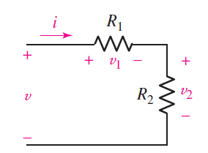

Voltage Division
$$v=v_{1}+v_{2}={(R}_{1}+R_{2})i$$
$$i=\frac{v}{R_{1}+R_{2}}$$
$$v_{1}=iR_{1}=\frac{R_{1}}{R_{1}+R_{2}}v$$
$$v_{2}=iR_{2}=\frac{R_{2}}{R_{1}+R_{2}}v$$

Slide 3
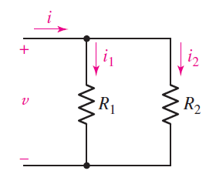

Current Division
$$i=i_{1}+i_{2}=\frac{v}{R_{1}}+\frac{v}{R_{2}}=v\left(\frac{1}{R_{1}}+\frac{1}{R_{2}}\right)$$
$$i_{2}=\frac{v}{R_{2}}=i\frac{\frac{1}{R_{2}}}{\frac{1}{R_{1}}+\frac{1}{R_{2}}}=i\frac{R_{1}}{R_{1}+R_{2}}$$
$$i_{k}=i\frac{\frac{1}{R_{k}}}{\frac{1}{R_{1}}+\frac{1}{R_{2}}+..+\frac{1}{R_{N}}}$$

Slide 4
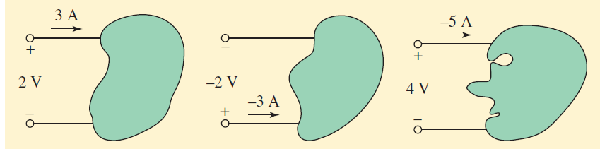
Problems:
Calculate the power absorbed?
1.

Slide 5
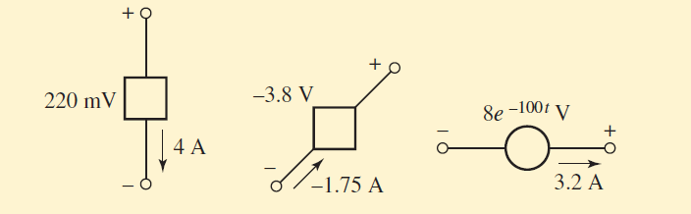
2.
(a)
(b)
(c)
(a) Calculate the power absorbed?
(b) Calculate the power being generated by the circuit element?
(c) Calculate the power being delivered to the circuit element at t=5 ms?

Slide 6
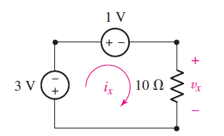
3.

Slide 7
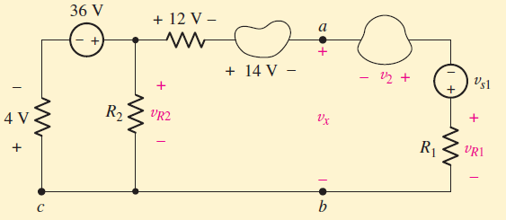
4.

Slide 8
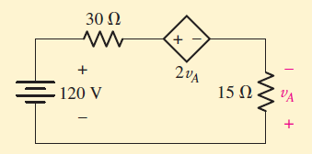
5.

Slide 9
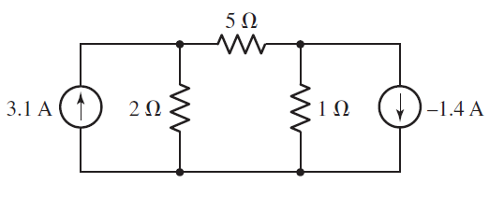
Nodal Analysis
N-node circuit will need (N − 1) voltages and (N − 1) equations. Each equation is a simple KCL equation.
Problem 1:

Slide 10
Summary (Nodal Analysis)
Count the number of nodes (N).
2. Designate a reference node.
3. Label the nodal voltages (there are N − 1 of them).
4. Write a KCL equation for each of the nonreference nodes.
5. Express any additional unknowns such as currents or voltages other than nodal voltages in terms of appropriate nodal voltages.
6. Organize the equations.
7. Solve the system of equations for the nodal voltages

Slide 11
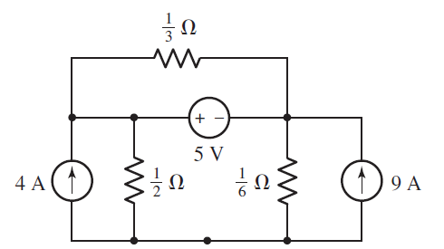
Supernode

Slide 12
Supernode (Cont.)

Slide 13
Summary (Supernode Analysis)
Count the number of nodes (N).
2. Designate a reference node.
3. Label the nodal voltages (there are N − 1 of them).
4. If the circuit contains voltage sources, form a supernode about each one.
5. Write a KCL equation for each nonreference node and for each supernode that does not contain the reference node.
6. Relate the voltage across each voltage source to nodal voltages.
This is accomplished by simple application of KVL; one such equation is needed for each supernode defined.
7. Express any additional unknowns (i.e., currents or voltages other than nodal voltages) in terms of appropriate nodal voltages.
8. Organize the equations.
9. Solve the system of equations for the nodal voltages.

Slide 14
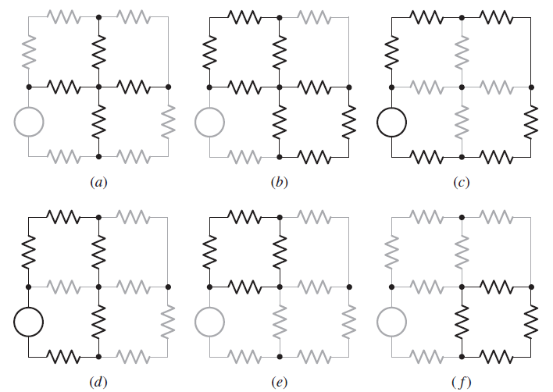
Mesh Analysis
A mesh is a loop that does not contain any other loops

Slide 15
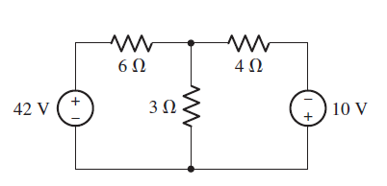
Mesh Analysis (Cont.)

Slide 16
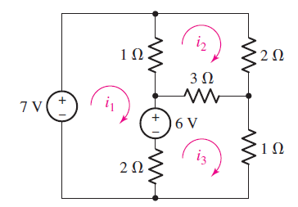
Mesh Analysis (Cont.)

Slide 17
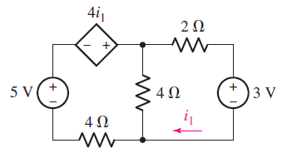
Mesh Analysis (Cont.)

Slide 18
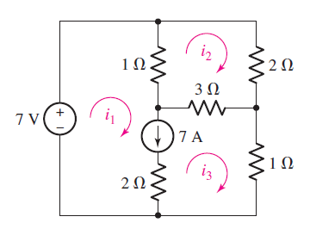
Supermesh Analysis
If two meshes have a current source as a common element, then it is a supermesh problem.

